Slide 1
Pólya’s principles of problem-solving
In 1945 George Polya published the book How To Solve It which quickly became his most prized publication. It sold over one million copies and has been translated into 17 languages. In this book he identifies four basic principles of problem solving

Slide 2
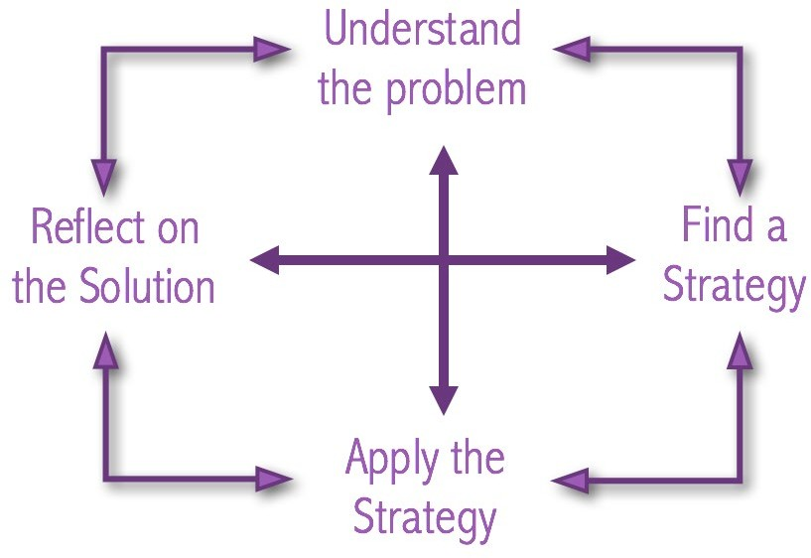

Slide 3
Pólya’s principles of problem-solving
Understand and explore the problem
Find a strategy
Apply the Strategy : Use the strategy to solve the problem
Look back and reflect on the solution

Slide 4
Polya’s First Principle: Understand the problem( Ask these question )
Do, I understand all the words used in stating the problem?
What is being asked to find or show?
Can, I restate the problem in my own words?
Can, I think of a picture or diagram that might help me understand the problem? Is there enough information to enable me to find a solution?

Slide 5
Polya’s Second Principle: Devise a plan
Polya mentions that there are many reasonable ways to solve problems.
The skill at choosing an appropriate strategy is best learned by solving many problems.

Slide 6
Polya’s Second Principle: Devise a plan
Guess and check • Look for a pattern
Make an orderly list • Draw a picture
Eliminate possibilities
Use symmetry • Use a model
Consider special cases • Work backwards
Use direct reasoning • Use a formula
Solve an equation • Be ingenious

Slide 7
Polya’s Third Principle: Carry out the plan
This step is usually easier than devising the plan. In general, all you need is care and patience, given that you have the necessary skills. Persist with the plan that you have chosen. If it continues not to work discard it and choose another. Don’t be misled, this is how mathematics is done, even by professionals.

Slide 8
Polya’s Fourth Principle: Look back
Polya mentions that much can be gained by taking the time to reflect and look back at what you have done, what worked, and what didn’t. Doing this will enable you to predict what strategy to use to solve future problems.

